Slide 1






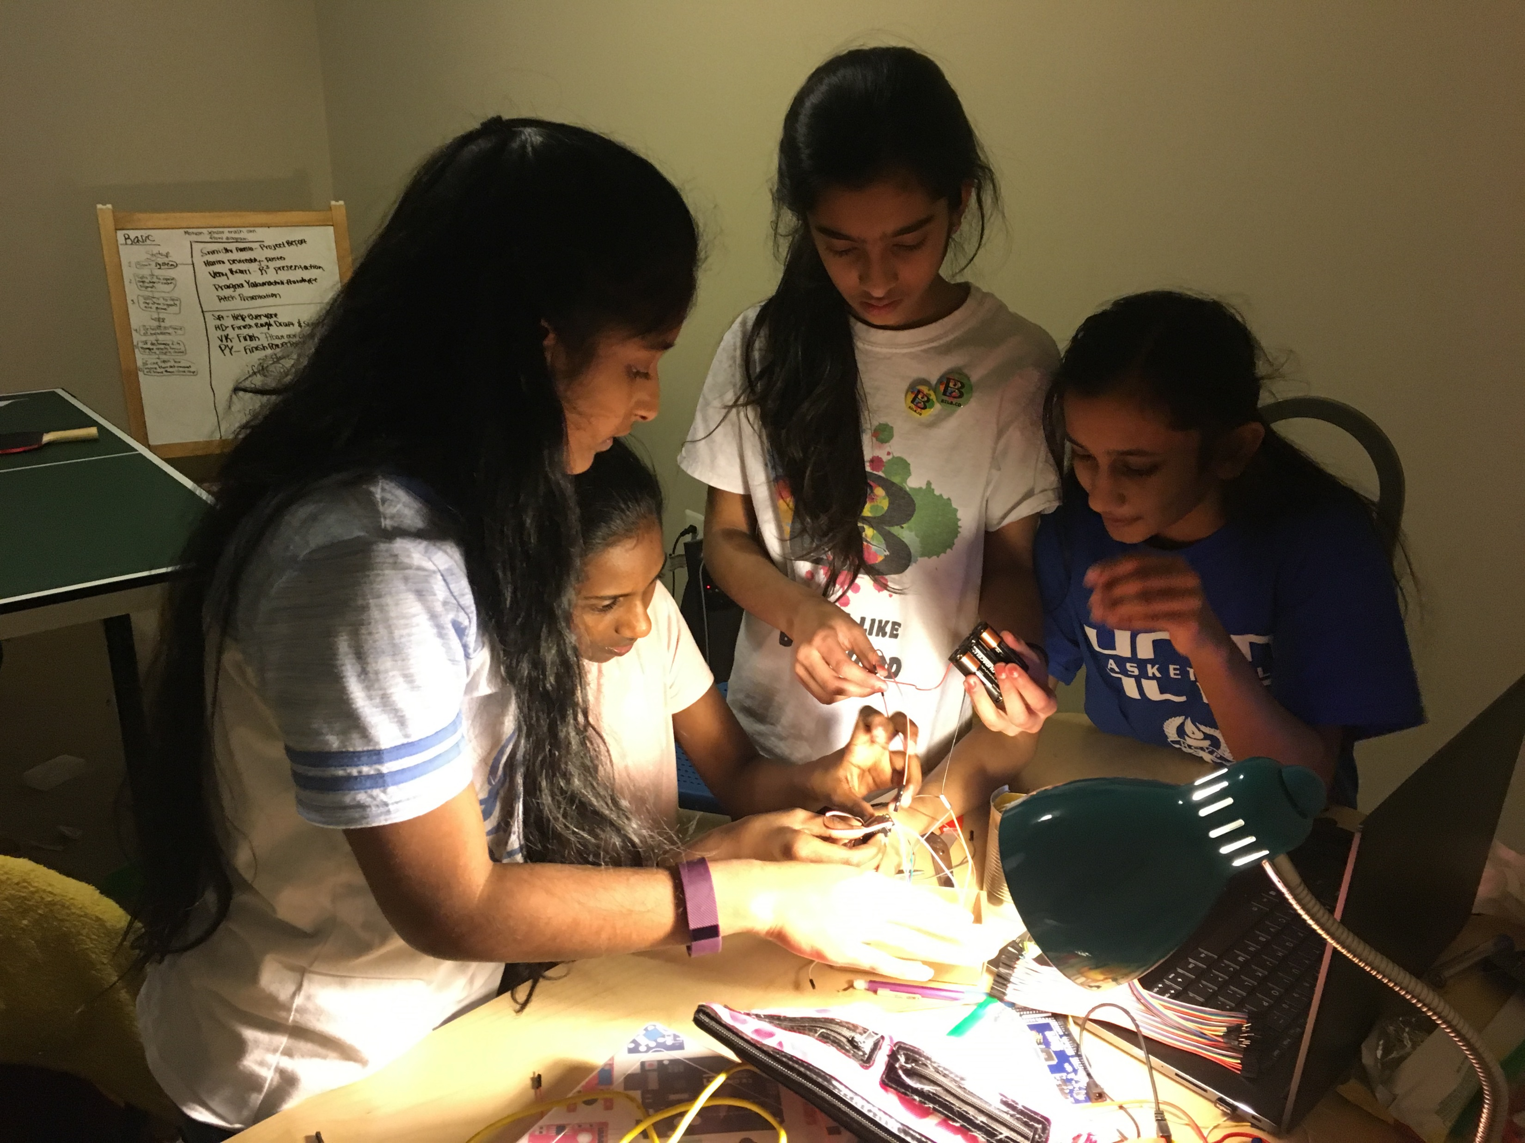

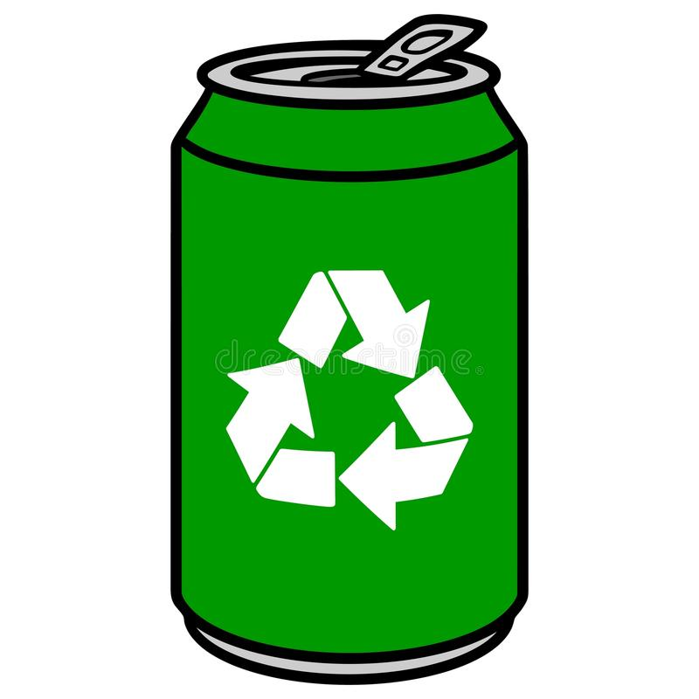
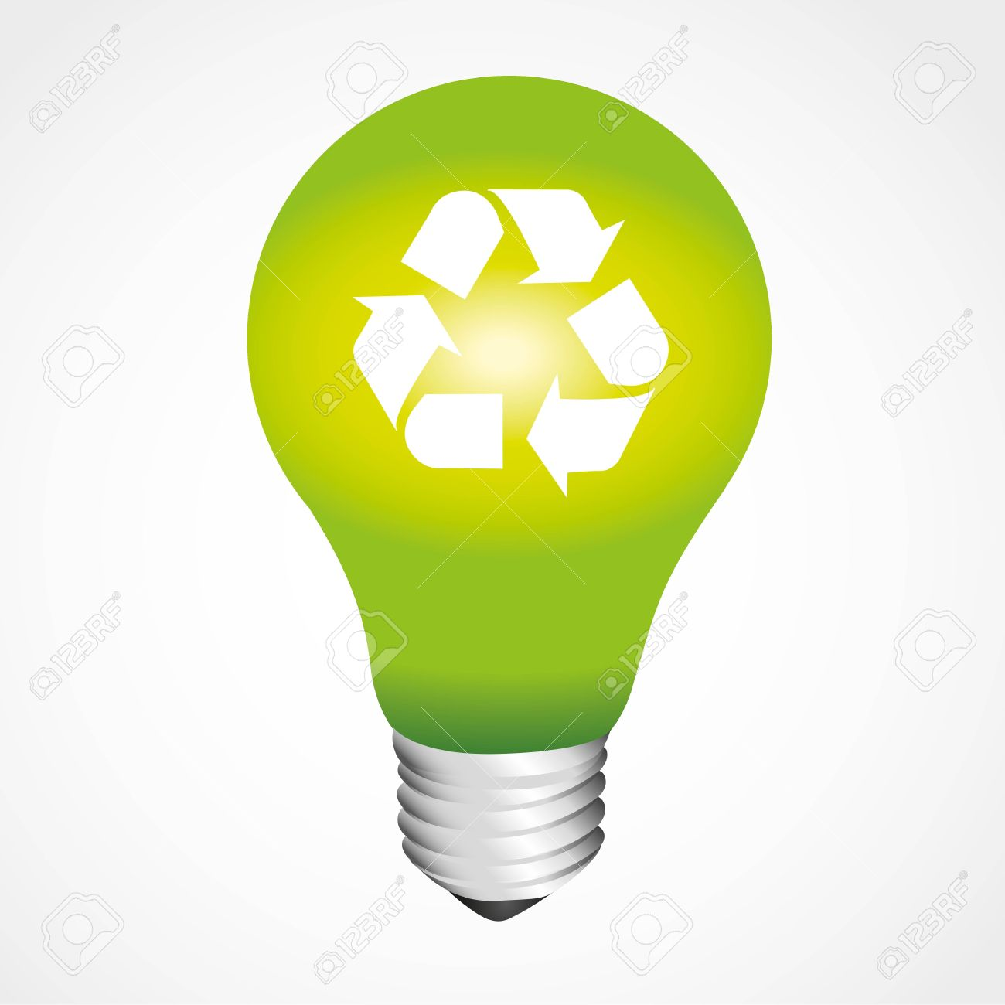
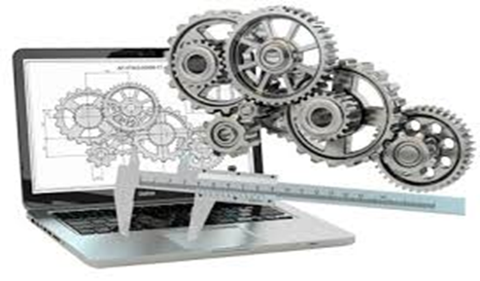
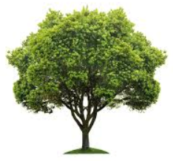
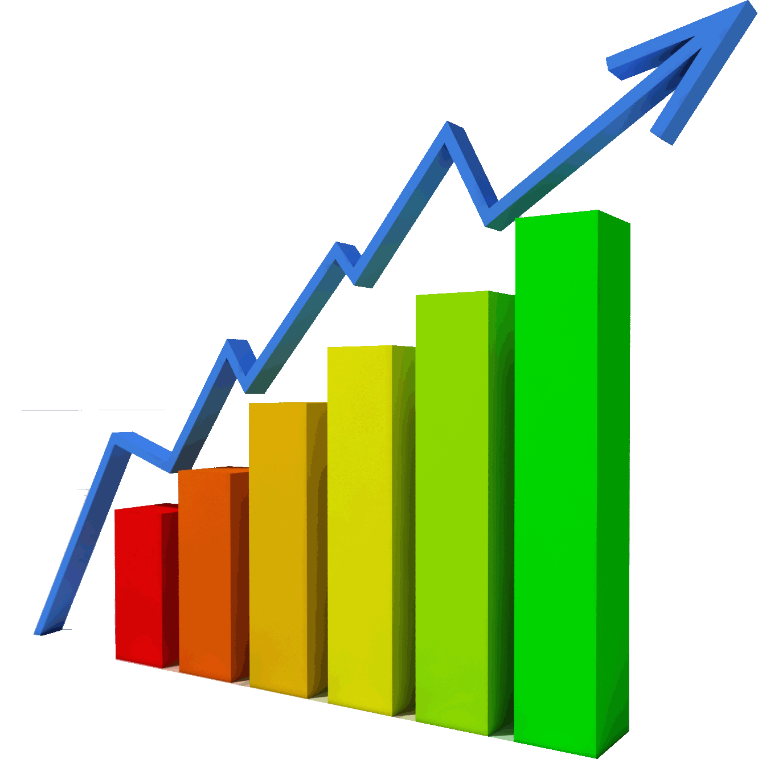
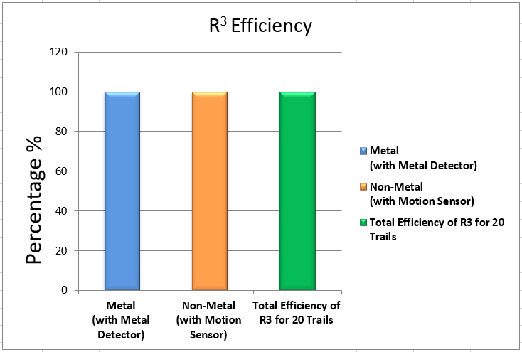

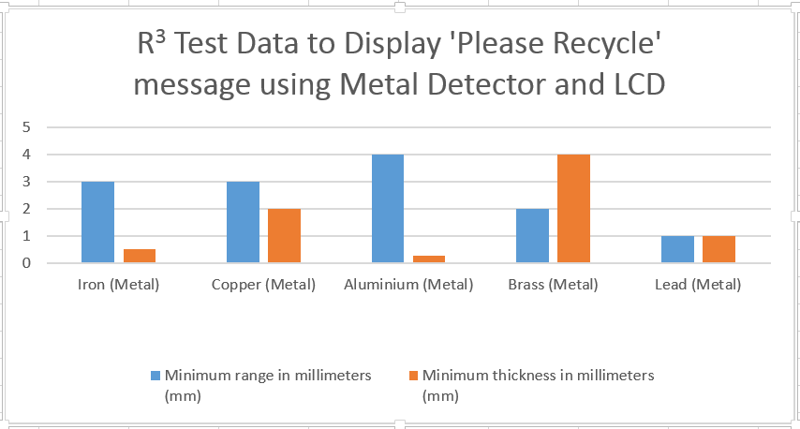
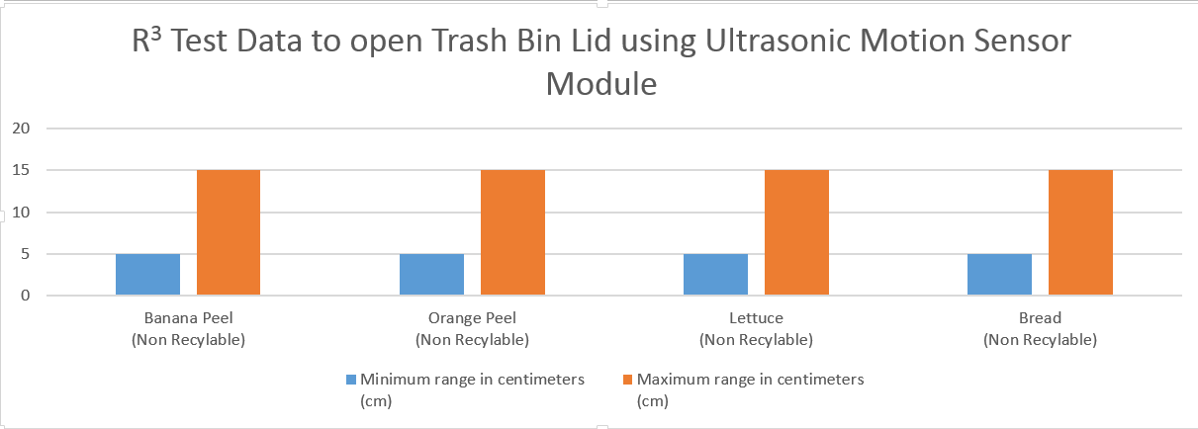


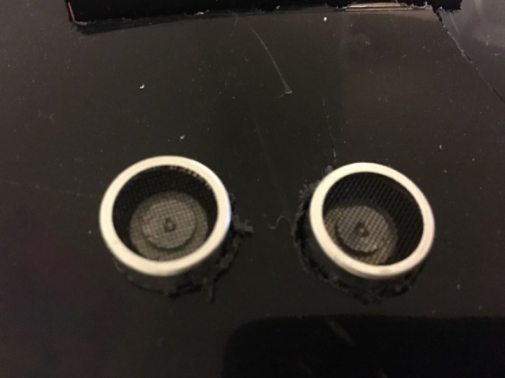
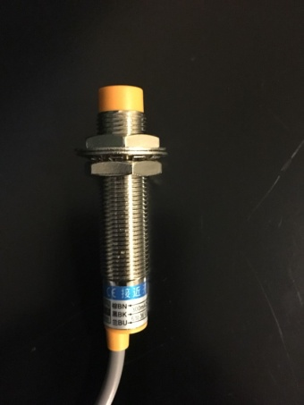
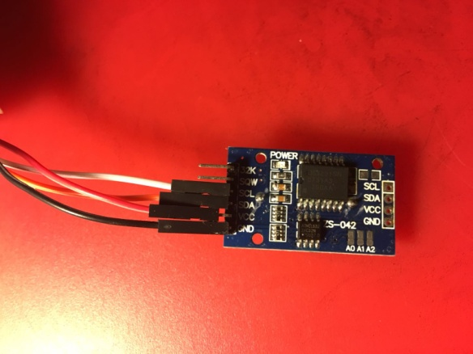
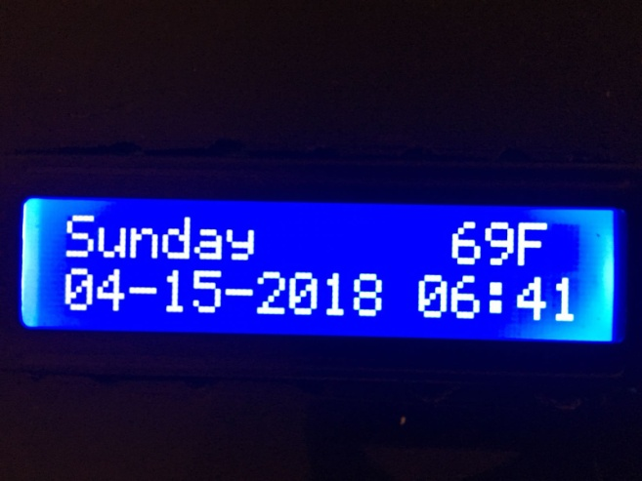
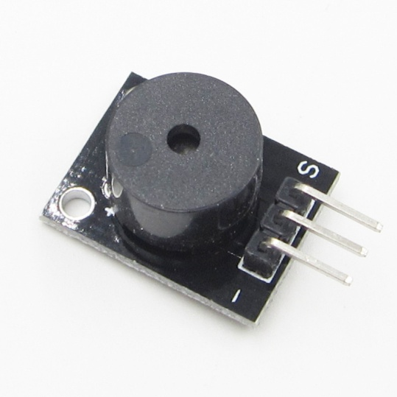
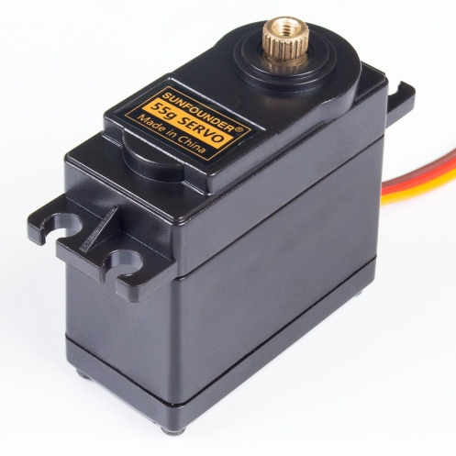
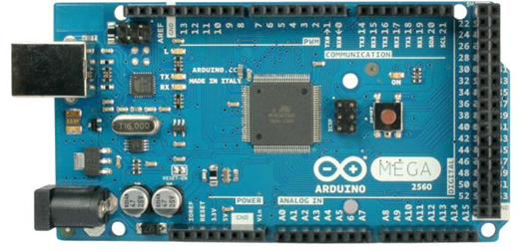
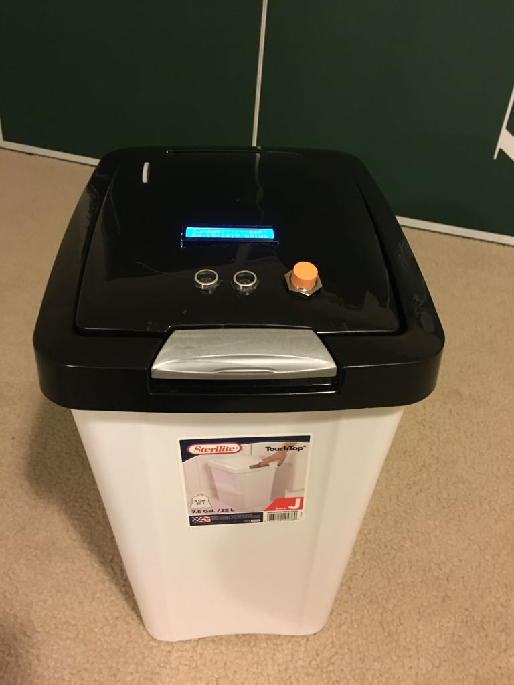
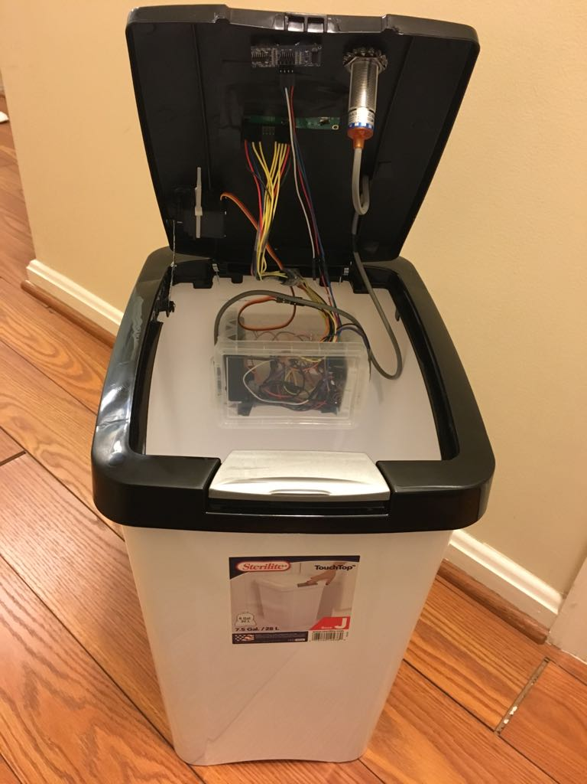
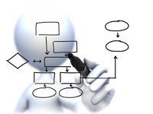
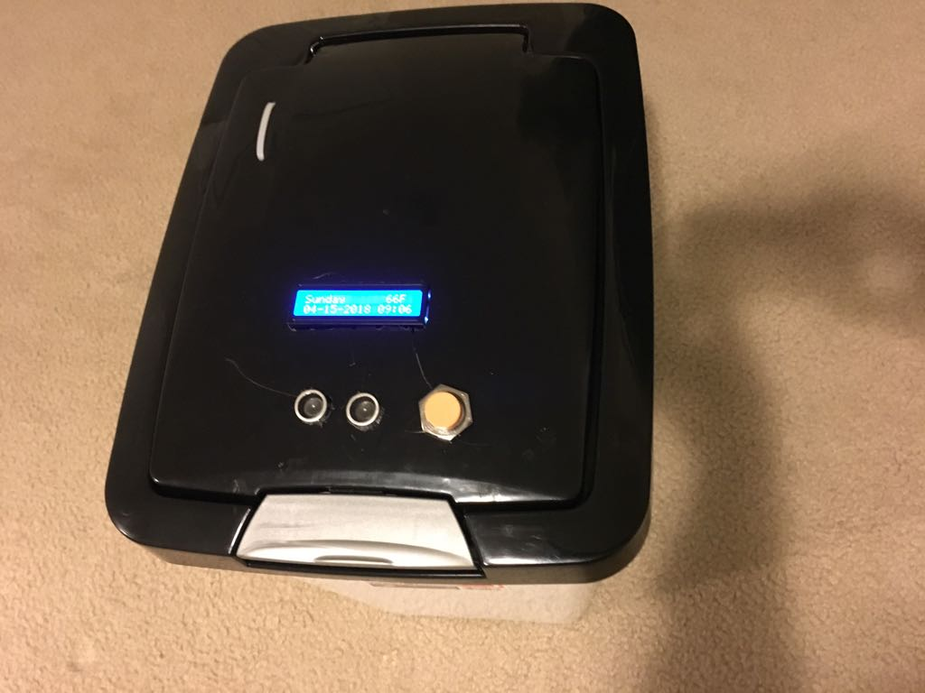
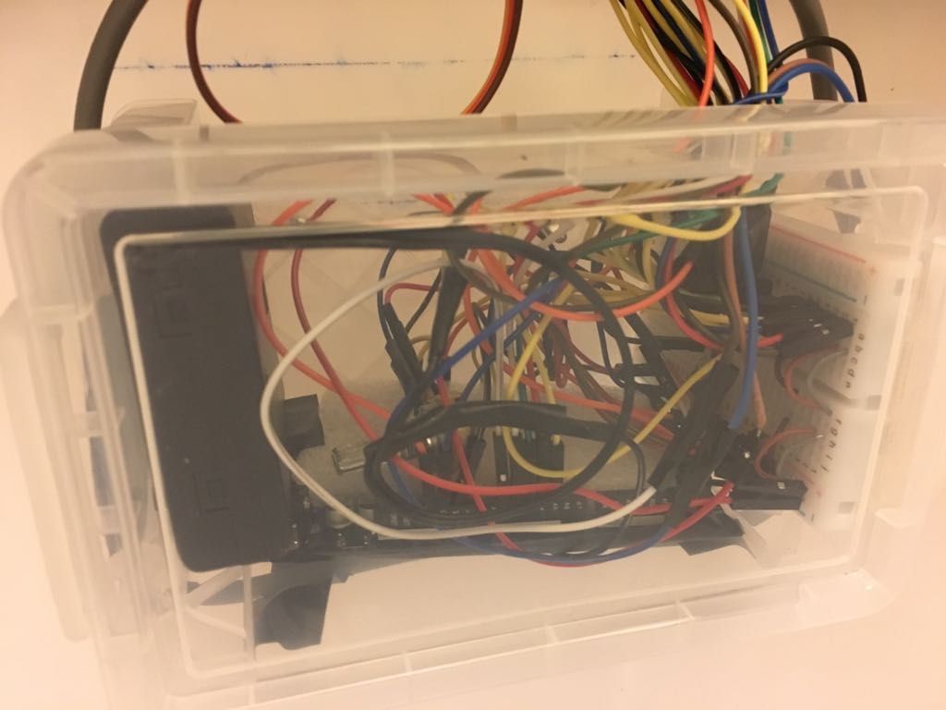

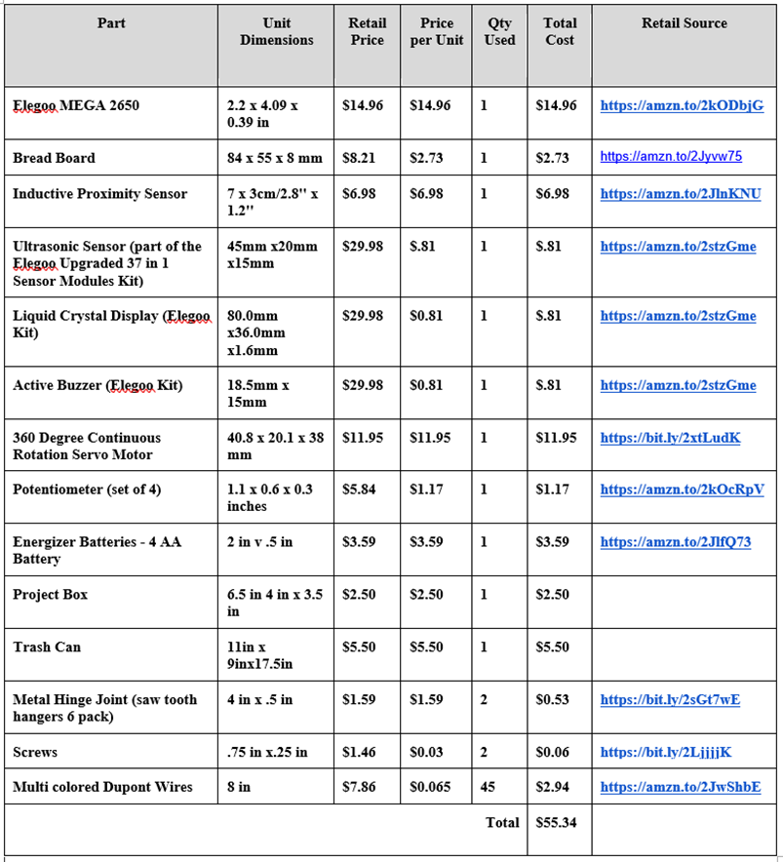

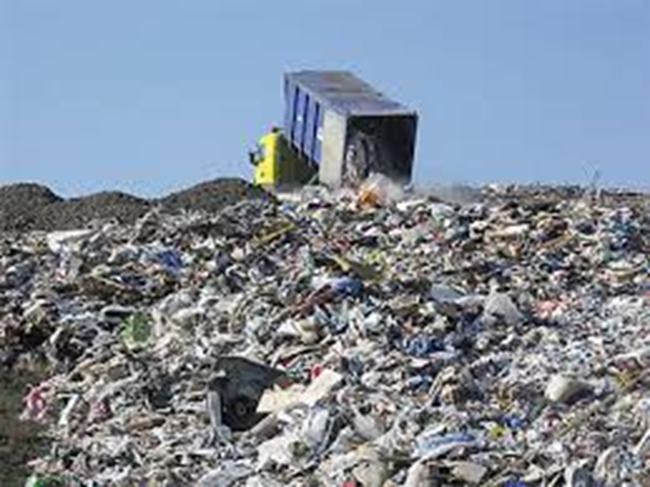
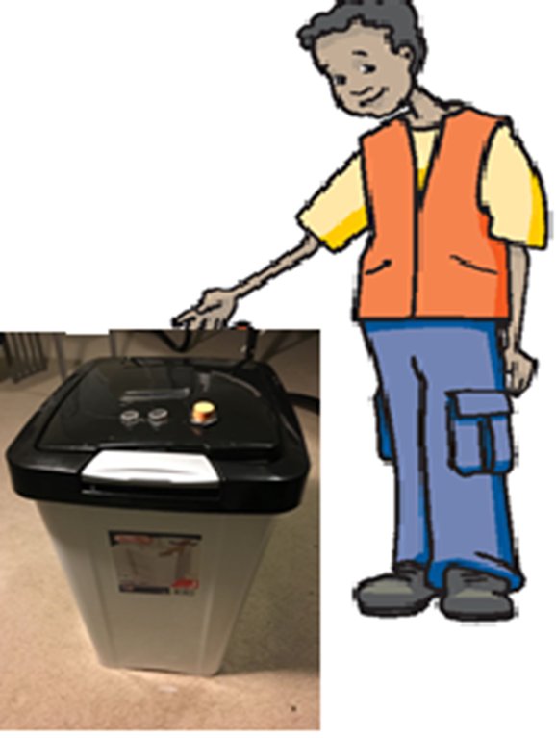

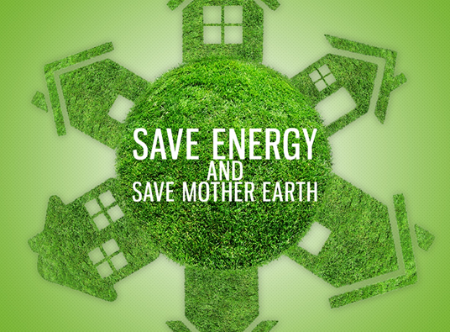
S
Problem Statement
As per a 2013 Environmental Protection Agency study, an average American wastes about 4.4lbs of materials per person every day. Majority of the recyclable items are filled in landfills.
Based on our research, there is no distinct product that can identify all types of recyclable items with appropriate prompts to avoid intermix of trash and recyclable items.
School: Patapsco Middle School
Grade: Middle School (6th)
State: Maryland
Team Name: The RoboKnights
Team Members:
Harini Devireddy
Pragna Yalamanchili
Srinidhi Akella
Venya Karri
School Coordinator: Ms Stephenson
Recycling 1 ton of plastic can save an equivalent of 2 peoples energy for 1 year.
Manufacturing products for recycled paper and plastic reduces water pollution by 35% and air pollution by 73%.
One plastic bottle can save enough energy to power a 60 watts light bulb for 6 hours.
It takes about 25 recycled bottles to make a fleece jacket.
Ask:
Durability of the device, condition of recyclables.
Too many recyclable items in landfills can lead to pollution.
Recycling can save a lot of energy.
Research/Brainstorming: We researched case studies on:
How our community’s recycling efforts are.
How our community’s trash ends up in landfills and affects the environment
Researched on existing tools their capabilities and deficiencies
Imagine:
We considered 3 solution approaches and shortlisted one option - Designed a device to identify recyclable items thrown in trash bin with lid
Plan:
Design and development work is split into 3 modules - Metal Detector, Motion detector and Display Panel.
Create:
Implement/Program above 3 modules and build corresponding circuits.
Engineering Design Process
Test and Evaluate:
Performed the unit test for each module separately and captured the test results for the relevant scenarios.
Improve:
The prototype can be enhanced for greater range of detecting items.
Share Solution:
The key strength of the current prototype model is uniqueness of the product to deliver metal detection, LCD display and auto lid open/close.
Science Connection: Environmental/Earth Science
R³ reduces greenhouse gases and toxic chemicals from landfills
Math connection:
Used Plane Geometrical math concepts like Dihedral Angles for the trash bin lid's open and close angles.
R³ costs inexpensive product. Please refer the budget table below.
R³ Efficiency = Successful Trials / Total Trials in percentage.
Graphs
Objective
Efficiently segregate recyclable items from trash to save energy and the environment
User Requirements
(Goals/Constraints)
Need a device to identify recyclable items and restrict recyclable items to be intermixed with trash.
Needs to be weather proof and avoid damage from trash inside the container
Needs to have display panel for friendly usability and buzzer prompting.
Efficient proximity sensing of recyclable items.
Scope is limited for home usage- needs further improvements for commercial usage.
Recyclables should be fed individually to container.
Conclusion
The device has foundational framework with focused capabilities but has potential to be fully extendable to meet broader diversified needs
Key Advantages
Minimizes intermixing of recyclable with trash in turn helps
Reduction of chemical toxic gases generation from Landfills
Increased Opportunity on recycling and saves energy
Key Strengths
Supports metal detection to avoid intermixing with trash and provides recycle opportunity
The device is very user friendly - displays a LCD message and buzzer to prompt user to recycle the item
If the item is recyclable, the lid does not automatically open
Input Devices:
Inductive Proximity RTC
Ultrasonic Sensor Sensor
Output Devices:
LCD Piezo Buzzer DC-Servo
R³ Prototype
Arduino Mega 2560 Front View Top View Open View Integrated Device Box
Process Flow Diagram
Recommendations
Consider below capabilities for future enhancements for multi iteration releases for full blown product
Plastic, cardboard, paper and glass sensing are must have capabilities
Notification to user’s phone with recycled material data would be a valuable addition in the future.
Extend product capabilities from residential to commercial usage.
Reduce landfills, use R3 device, to save the environment

